Slide 1

K - Nearest Neighbors (KNN)

Slide 2
Overview
Core idea of KNN
Distance Scores
KNN for Classification and Prediction
Advantages and Disadvantages of KNN
Summary

Slide 3


S U P E R V I S E D
Categorical Outcome
Pass / Fail Purchase / No purchase,
Fraudulent / Genuine Creditworthy / Defaulter Owner / Non-owner
Classification
Prediction
(referred to as regression also)
L E A R N I N G
Total Marks scored
Total Amount spent on purchase Amount of Fraud Amount of Default
Net worth
Numerical Outcome

Slide 4
Characteristics of KNN Algorithm
KNN can used for classification(categorical outcome) as well as prediction (numerical outcome).
Data Driven
Little or no prior knowledge about the distribution of the data, i.e. there are no assumptions about the data such as normality
Non-parametric
Unlike parametric models which have fixed number of parameters, in a non-parametric model, the complexity of the model grows with the number of training data
Instance-based learning/Case-based learning/Memory-based learning/Lazy learning
instead of performing explicit generalization, new instances are compared with instances stored in the memory during training, wherein the computation is delayed until classification

Slide 5
Core Idea of KNN
For a new datapoint to be classified, identify the nearby records
“Nearby” means the labeled datapoints with similar predictor values
x₁, x₂, … x_{p}
Classify the datapoint as belonging to the majority class among the nearby datapoints (the “neighbors”)

Slide 6
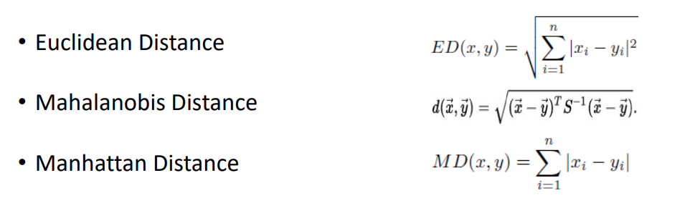


Distance Scores
(𝑥₁,𝑦₁)
(𝑥₂,𝑦₂)
𝑥₁ −𝑥₂
2 ₊
𝑦₁ −𝑦₂
2
Euclidean Distance
Mahalanobis Distance
Manhattan Distance
Chebychev Distance
Minkowski
Hamming
…
Ref: V. B. S. Prasath et al, Effects of Distance Measure Choice on KNN Classifier Performance - A Review, https://arxiv.org/pdf/1708.04321.pdf

Slide 7
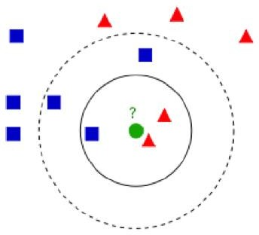
Basic KNN Algorithm - Classification
Input : Training Set D, Test datapoint d, Parameter k Output : Class label of Test datapoint d
Compute the distance between test datapoint d and every datapoint in the training set D
Choose the k datapoints in training set D that are nearest to test sample d; denote this set by P (∈ D)
Assign the test datapoint d to the most frequent class (majority class)
Ref: V. B. S. Prasath et al, Effects of Distance Measure Choice on KNN Classifier Performance - A Review, https://arxiv.org/pdf/1708.04321.pdf

Slide 8
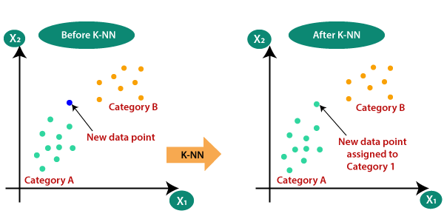

Slide 9
Step-1: Select the number K of the neighbors (k=5)
Step-2: Calculate the Euclidean distance of K number of neighbors
Step-3: Take the K nearest neighbors as per the calculated Euclidean distance.
Step-4: Among these k neighbors, count the number of the data points in each category.
Step-5: Assign the new data points to that category for which the number of the
neighbor is maximum.

Slide 10
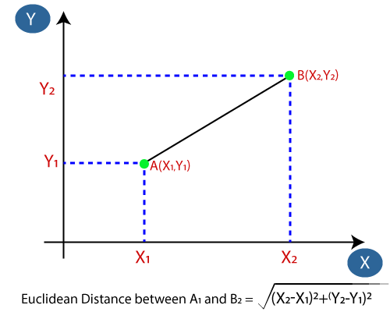

Slide 11
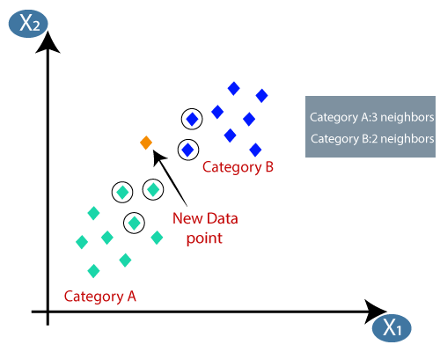

Slide 12
How to choose k
k is the number of nearby neighbors to be used to classify the new record
K=1 means use the single nearest record
K=3 means use the 3 nearest records
Low values of k (1, 3, …) capture local structure in data (but also noise)
High values of k provide more smoothing, less noise, but may miss local structure
extreme case of k = n (i.e., the entire data set) is the same as the “naïve rule” (classify all records according to majority class. Here the relevance of predictors vanish and we can avoid the computation of distance scores altogether. Enough to just look at the proportion of outcome labels and choose the majority)
Odd values of k preferred, to avoid tie caused by even values of k during majority voting

Slide 13
KNN for Prediction/Regression (for Numerical Outcome)
Use average of outcome values, instead of “majority vote”
Weighted average, weight decreasing with distance, etc

Slide 14
Advantages of KNN
Disadvantages of KNN
Lazy learning where computation is delayed until classification and hence need to compute distance scores each time
Time consuming when dealing with large datasets
Computational costs when applied to high dimensional data (‘curse-of- dimensionality’)
Simple approach and robust to noise in training data
Learns complex structures in data easily (relatively) without having to define any statistical model
Little or no prior knowledge about the distribution of the data, i.e. there are no assumptions about the data
Can be used for ‘imputation’ of
missing data

Slide 15
Summary
KNN is a data driven, non-parametric approach
Simple but powerful technique that selects k-nearest neighbors based on distance scores
Can be used for both Classification and Prediction(Regression)
Performance impacted by high dimensional data as well as volume of data.

Slide 16
If we have data from a survey which have an objective of testing with two attributes (acid durability and strength ) to classify whether a special paper tissue is good or not.
We have given 4 data samples.
Acid durability(x1) | Strength(x2) | Classification(y)
7 | 7 | Bad
7 | 4 | Bad
3 | 4 | Good
1 | 4 | Good
Using this data, Classify the new data that pass the laboratory test with
x1=3 and x2=7. Assume k=3.

Slide 17
Suppose we have height, weight and T-shirt size of some customers and we need to predict the T-shirt size of a new customer given only height and weight information we have. Data including height, weight and T-shirt size information is shown below -
Height (in cms) | Weight (in kgs) | T Shirt Size
158 | 58 | M
160 | 60 | M
163 | 61 | M
163 | 64 | L
168 | 62 | L
170 | 64 | L
Using this data, classify a new data point with height 161cm and weight 61kg. Assume k=3.

Slide 18
Sepal Length | Sepal Width | Species
5.3 | 3.7 | Setosa
5.1 | 3.8 | Setosa
7.2 | 3.0 | Virginica
5.4 | 3.4 | Setosa
5.1 | 3.3 | Setosa
5.4 | 3.9 | Setosa
7.4 | 2.8 | Virginica
6.1 | 2.8 | Verscicolor
7.3 | 2.9 | Virginica
6.0 | 2.7 | Verscicolor
5.8 | 2.8 | Virginica
6.3 | 2.3 | Verscicolor
5.1 | 2.5 | Verscicolor
6.3 | 2.5 | Verscicolor
5.5 | 2.4 | Verscicolor
Use KNN classifier to classify new IRIS sample
Using this data, Classify the new sample, K=5
Sepal Length | Sepal Width | Species
5.2 | 3.1 | ?

Slide 19
Readings
https://www.analyticsvidhya.com/blog/2018/08/k-nearest-neighbor- introduction-regression-python/
https://machinelearningmastery.com/k-nearest-neighbors-for- machine-learning/
https://arxiv.org/pdf/1708.04321.pdf

